Slide 1
Pharmaquant
Hackathon
Ayan Saha
Ayush Ghatak
Siddhartha Sen
Soumyadeep Roy

Slide 2
Data Description
Clinical Features (Medical and health-related attributes)
Number of lab procedures (num_lab_procedures)
Number of procedures (num_procedures)
Number of medications (num_medications)
Number of outpatient visits (number_outpatient)
Number of emergency visits (number_emergency)
Number of inpatient visits (number_inpatient)
Number of diagnoses (number_diagnoses)

Slide 3
Treatment-Related Features (Hospitalization and medication-related attributes)
Admission type (admission_type_id)
Discharge disposition (discharge_disposition_id)
Admission source (admission_source_id)
Time in hospital (time_in_hospital)
Change of medications (change)
Diabetes medications (diabetesMed)
24 medication-related features (metformin to metformin.pioglitazone)
Demographic Features :
Race
Gender (gender)
Age (age)
Weight (weight)

Slide 4
Objective of our Analysis
We are trying to analyse readmission rates based on different clinical features, demographic features and treatment related features.
Reason behind the chosen objective :
There is a certain threshold value of readmission rates above which hospitals get penalised in US. HRRP is a Medicare value-based program that encourages hospitals to improve communication and coordination with patients to reduce avoidable readmissions. This is in relation to the fact that 83% of the hospitals in US face penalty because of violating this HRRP act. We are conducting our analysis to address this issue from the hospital’s point of view.
https://www.cms.gov/medicare/quality/value-based-programs/hospital-readmissions

Slide 5
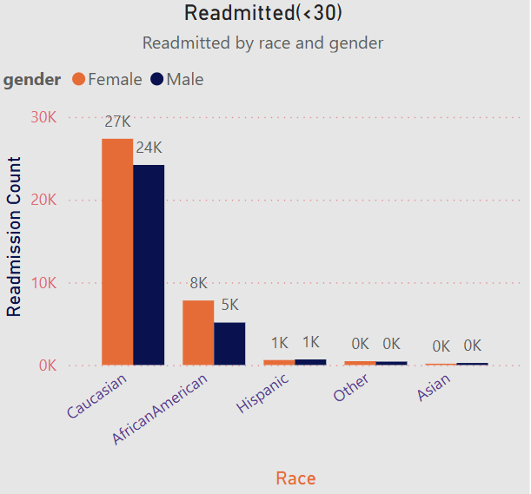
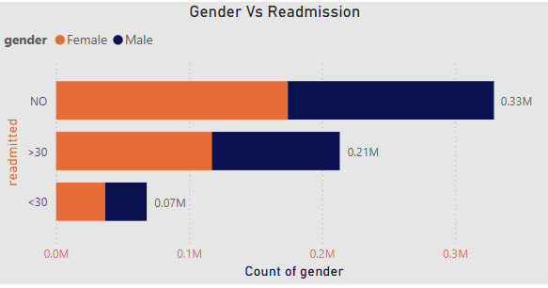
Re-admission counts based on Demographic features (Patient background and personal attributes) :

Slide 6
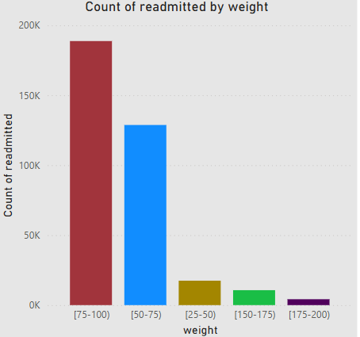
Within 30 days readmission(Weight in pounds)
o

Slide 7
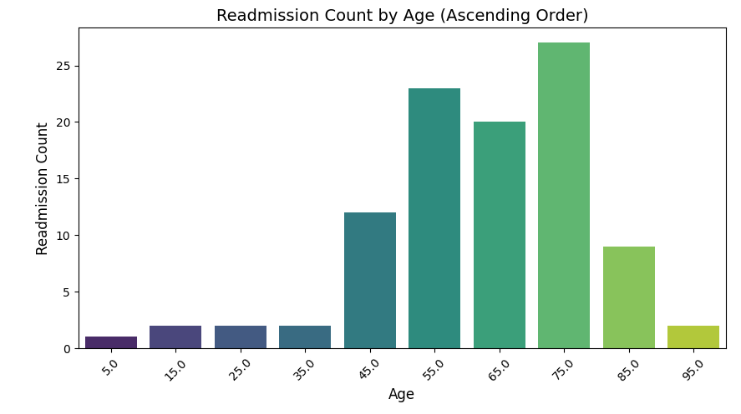

Slide 8
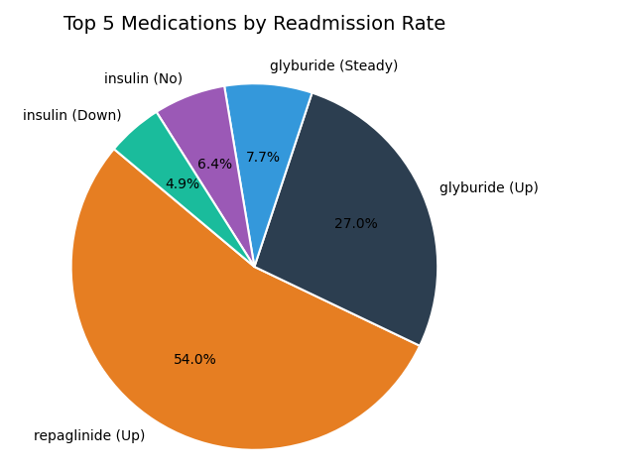

Slide 9
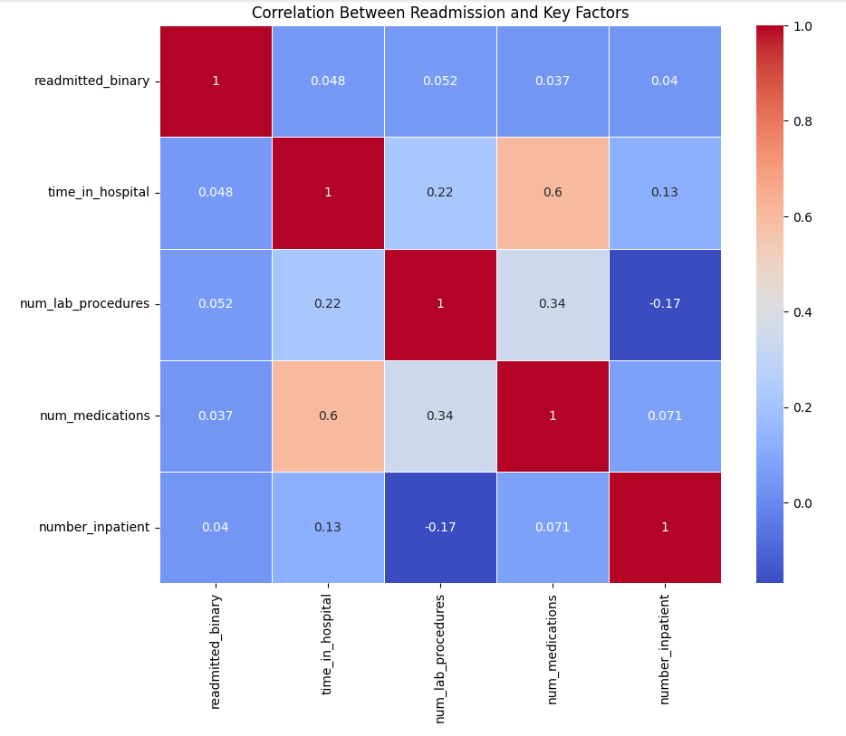
Strongest relationship: Time in hospital & medications (0.6).
Weak correlations:
Time in hospital & lab procedures (0.22).
Lab procedures & medications (0.34).
Very weak correlations:
Time in hospital & inpatient visits (0.13).
Medications & inpatient visits (0.071).
Weak negative correlation: Lab procedures & inpatient visits (-0.17).
Conclusion: These factors alone are not strong predictors of readmission.
However, correlation doesn’t imply causation. Therefore, we need to proceed with further tests to actually find the significant predictors.
Correlation Heatmap

Slide 10
Data Cleaning and Preprocessing
We removed the following data columns from our analysis : Unnamed, encounter_id, Patient_nbr, payer_code, medical_specialty, max_glu_serum, A1C result. All these columns are irrelevant to our analysis and some of them occur with huge no of null values.
The ‘weight’ column has a considerable no of null values but at the same time its significant in analyzing the readmission rates. We could have used KNN to impute the null values but since we have high no of predictors here its not suggested to use KNN.
So we are imputing the null weight values by replacing them with the median value of weight of those patients who have been clustered based on similar demographic features.

Slide 11
Analysis
Which features best predict readmission within 30 days ?
We have treated this as a binary classification problem for which we are using logistic regression , random forest and XGBoost.

Slide 12
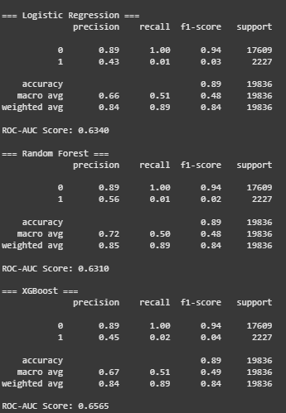
Results
On the basis of accuracy, all our 3 models perform equally well in predicting whether a patient would be readmitted within 30 days.
However, on the basis of ROC-AUC score, XGBoost performs slightly better than the other 2 because of its capability to handle non linear relationships (common in healthcare data and the fact that it uses both l1 and l2 regularization to prevent overfitting.

Slide 13
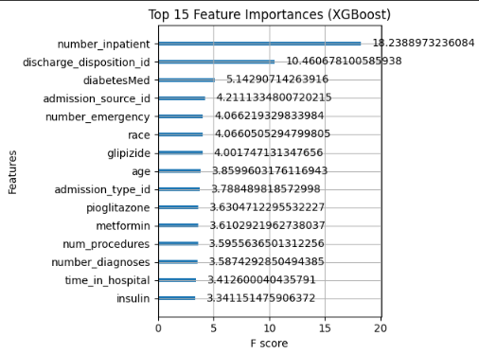
We find that the following predictors are most crucial in predicting the readmission of patients within 30 days. Also, the – model fits the data best as is clear from the result table. This can be used as an estimate of a patient getting readmitted within 30 days.

Slide 14
Actionable Insights
Implement post-discharge follow-up programs for high-risk patients.
Improve care coordination to reduce unnecessary readmissions.
Analyze which discharge dispositions lead to frequent readmissions.
Optimize discharge planning and provide better transition care.
Track medication adherence and adjust prescriptions as needed.
Provide patient education programs on diabetes self-management.
Strengthen outpatient and telehealth services to reduce ER visits.
Improve triage systems to ensure better resource utilization.

Slide 15
Identification of different patient clusters
We have segmented diabetic patients into distinct groups based on demographics, treatment history, hospital usage, and health indicators to identify patterns in readmission, severity, or healthcare needs.
We choose relevant features like:
age,gender,race,time_in_hospital,no_lab_procedures, no_procedures,no_of_medications,no_inpatients,no_outpatients,no_emergency,change_diabetesMed

Slide 16
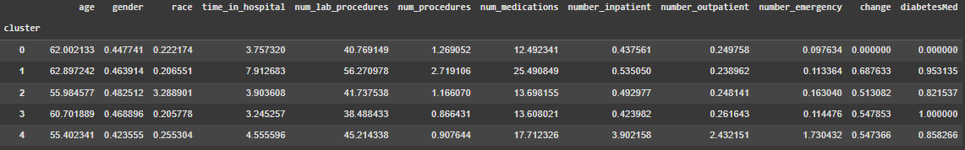
Summary of the clusters:

Slide 17
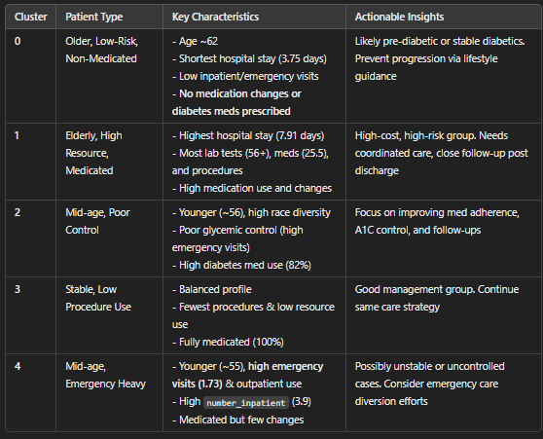
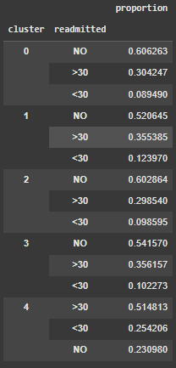

Slide 18
Thank You !!

